Slide 2
Call for proposals:
Enabling City Transformation 2 (ECT2)
Information session 1 / 3
Tuesday 15 September 2026

Slide 3




Overview
Welcome and call framing (10 mins)
Challenge based approach (20 mins)
Scope (10 mins)
Impact (10 mins)
Timeline and key information (10 mins)
Q&A (remaining time as required)
This event is being recorded
Use the Q&A functionality to ask questions
Re/Name yourself and include your city and department

Slide 4

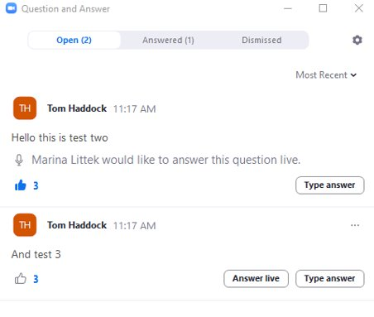
How to use the Q&A
1) Type down your questions
2) Vote up the questions

Slide 5
This info session…
Is for Mission Cities considering a 22-month, grant-supported programme of interventions that remove the barriers blocking whole-city transformation, in the context of the EU Cities Mission.
We will cover
  The ambition and approach of ECT2, and what has changed since the first ECT call
  The six challenge areas, and how impact pathways work
  Overview of the eligible activities, funding and the call timeline
We will not cover in detail today
  Eligibility, assessment criteria and the submission platform – 29 September
  The Impact Framework, indicators and MEL – 9 October
Please keep questions relevant to the content of this session.

Slide 6









Pilot Cities and Enabling City transformation Programmes Team
Jessica Fonti
Funded Innovation Programmes Project Manager
Mateusz Hoffmann
Funded Innovation Programmes Project Officer
Nikhil Chaudhary
Funded Innovation Programmes Strategic Learning Lead
Kimmy Lahr
Funded Innovation Programmes Project Officer
Nicholas Ansell
NetZeroCities Portfolio Learning and Impact Manager
Ilenia Piergallini
Funded Innovation Programmes Learning & Impact specialist
ECT team: E: ect@netzerocities.eu
Experts interface E: experts@climate-kic.org

Slide 7
Key speakers
Jessica Fonti
Programme Manager
EIT Climate-KIC
Thomas Osdoba
NetZeroCities Director
Nikhil Chaudhary
MEL & Impact Orchestrator
Democratic Society
Nicholas Ansell
Portfolio Learning & Impact Manager
EIT Climate-KIC

Slide 8
Call Framing

Slide 9
Welcome
Call launched – 31 August 2026
  Call Guidelines published on the NetZeroCities website and the EU Funding & Tenders Portal
  Submission platform open – Climate KIC Grant Management System
  Supporting documents: Call Guidelines, Annex 1 challenge area briefs, Financial Guidelines, call application templates.
Deadline – Thursday 3 December 2026, 12.00 CET
Three information sessions, all 11.00 CET
  15 September – Overview, ambition and approach (this session)
  29 September – Eligibility, assessment criteria and how to submit
  9 October – Impact Framework and Monitoring, Evaluation and Learning
  Register for all three at www.netzerocities.eu
Notes:
Call ID NZC-SGA3-HE-202608. Amendments, additional guidance and FAQs will be posted on the NZC website – encourage cities to check regularly.

Slide 10
Where ECT2 sits
Pilot Cities Programme
“test and learn”
102 cities · 32 countries
68 projects · €61.2m
Three cohorts
Key exploration:
What is your city struggling with?
Enabling City Transformation
“enable and scale”
48 cities · 19 countries
26 projects · €22.6m
18 months, Mar 2025–Sep 2026
Key exploration:
Where are the collective implementation challenges?
Enabling City Transformation 2
“enable and scale” + “unblock and sustain”
Expands the portfolio — sharper focus on what’s blocking cities’ transition
Translates enabling innovations into durable, policy-anchored delivery
Notes:
ECT1 runs to September 2026, so ECT2 is being launched as the first cohort completes. Cities should look across Pilot Cities and ECT1 activity and build beyond it, not repeat it.

Slide 11
What this call is asking for
A 22-month programme of interventions that:
  shifts the dial from testing and experimentation to whole-city transformation
  overcomes systemic implementation challenges, rather than isolated project gaps
  generates evidence fit for multi-city, pan-European replication and adoption
The principles driving the call
  Promote scaling and sustainability through knowledge harvesting, peer learning and replication
  Learn once, benefit all
  Inspire system transformation and accelerate change
  Best value for money

Slide 12
Challenge Based Approach

Slide 13




Towards a challenge-based approach
PREVIOUS APPROACH (ECT1)
Broad, domain-based support — no thematic guardrails
THE ECT2 SHIFT
A focused model, organised around clearly defined, shared systemic barriers and bottlenecks
OUR HYPOTHESIS
City progress is most often blocked by specific, diagnosable obstacles — organising delivery around those obstacles produces faster, more durable progress than generic or topic-based support.
Fund support explicitly around diagnosed barriers shared by Mission Cities
Identify the key impact pathways — what actually needs to change — and act on them
Help committed cities achieve breakthroughs that benefit the wider Cities Mission
Enable stronger peer learning and collaboration between cities
Barriers are grounded in evidence: Mission Cities’ Climate City Contracts, challenge-specific documentation, an EU policy and funding scan, and a landscape review of Horizon Europe projects.

Slide 14
How we arrived at six challenge areas
We followed our hunches and placed bets on where the priorities sit and built an initial longlist of nine challenge areas.
We published that longlist and asked cities for feedback.
Internal feedback was used complimentarily to city feedback.
Narrowed focus from nine areas to the six proposed for ECT2.
This is not the be-all and end-all. There are other areas, and more to explore. These six are the focus for this call.
Notes:
Be straightforward about this: it is a set of informed bets, tested against city feedback, not a claim that these are the only barriers that matter. Cities that see their barrier sitting outside the six should still talk to us – but the call is anchored to these.

Slide 15
What each brief gives you
Each of the six areas was developed into a brief, setting out:
  the bottlenecks and blockers holding cities back
  why the area is urgent now
  the demand signals we see across Mission Cities
  Proposed impact pathways
Why we included proposed pathways
  To help you orientate and navigate within a challenge area, inside certain parameters. They are the middle ground between being too vague and open-ended, and being too prescriptive and narrow.
  You can adopt a proposed pathway, adapt it, or develop your own – depending on local needs, fit and your climate strategy priorities.
Annex 1 to the Call Guidelines: ECT2 challenge area briefs, including potential impact pathways.

Slide 16
The six challenge areas
Place based heating and cooling
Urban energy systems
Large-scale building retrofits and renovations
Nature-based solutions at city scale
City Finance innovations for climate neutrality
Decarbonising urban mobility and logistics
Notes:
The areas are not silos. Cities can work transversally – bringing NBS into a mobility programme, or using finance as the route into an emission-domain challenge. The guidelines define the what; cities define the how, starting from their own context, actors and bottlenecks.

Slide 17

Place based heating and cooling
Unlocking the enabling conditions for coordinated, place-based heating and cooling that can be scaled from neighbourhood testing to city-wide transformation.
Why now
  Heatwaves in 2022, 2023 and 2026 caused tens of thousands of premature deaths, with the heaviest impacts in dense, low-income neighbourhoods. If each household responds alone with split-system air conditioning, cities face a self-reinforcing loop: more waste heat, hotter streets, more cooling demand.
What is blocking progress
  No clear owner is accountable for place-based heating and cooling outcomes, and there are no shared delivery models. Heat and vulnerability data exist but are not used in investment decisions. Networks are planned on long cycles, and cities have limited control over utility-owned, nationally regulated infrastructure.
Potential pathways
  Place-based thermal planning and prioritisation · Inclusive neighbourhood heating and cooling · Local and district thermal networks · City-wide scale, replication and coordination
Notes:
Strong neighbourhood pilots are welcome, but as a step rather than an end. This area is aimed especially at cities that have already tested place-based approaches and now need to work out how to finance, govern, scale or replicate them citywide.

Slide 18

Urban energy systems
Unlocking the enabling conditions for a coordinated city energy system that can deliver electrification, clean heat and flexibility at scale.
Why now
  Three transition windows are converging and cannot be run as separate workstreams: fossil-gas phase-out, industrial and data-centre integration, and affordability and acceptance. Decisions taken now on grid reinforcement, charging infrastructure and heat-pump rollout shape the system for decades.
What is blocking progress
  Grid readiness and heat-transition pathways remain unclear. Projects are not bundled into investable pipelines, and procurement rewards inputs rather than performance and delivery speed. Roles and mandates across cities, utilities, DSOs, TSOs and regulators are fragmented, so cities negotiate one-off arrangements instead of working from repeatable models.
Potential pathways
  Baseline and delivery mandate · Procurement-ready heat transition · Flexibility and grid-enabled electrification · Just transition

Slide 19

Large-scale building retrofits and renovations
Unlocking the enabling conditions for repeatable retrofit programmes that upgrade whole districts and portfolios.
Why now
  Practically every building in use in 2040 to 2050 is already built, so each year of delay compounds lock-in and cost. Policy and funding windows increasingly demand verifiable delivery and pipelines rather than aspirational roadmaps.
What is blocking progress
  Ownership is fragmented, and multi-owner residential buildings are a major structural bottleneck. Projects are not bundled into investable pipelines with repeatable unit economics. Procurement is not set up for scale and often rewards lowest price. Performance-gap risk undermines trust and finance, and heritage and safety frameworks add complexity.
Potential pathways
  Multi-owner retrofit conversion system · Public and social portfolio aggregation · Heat and grid-ready retrofit sequencing · Workforce and supplier delivery capacity

Slide 20

Nature-based solutions at city scale
Unlocking the enabling conditions for NBS to be planned, funded and maintained as core city infrastructure.
Why now
  Streets and sewers commonly last 30 to 50 years, so failing to build NBS into current renewal cycles locks cities into grey infrastructure for decades. Residents increasingly expect cooler, greener neighbourhoods – and trust erodes when visible projects are not maintained or do not scale.
What is blocking progress
  Governance is fragmented and no single owner feels responsible for the end-to-end system. Cities can usually fund construction, but not the long-term ecological maintenance, skills, monitoring and operating budgets. Data and measurement are not fit for purpose, so the value case is hard to prove to finance departments and private owners.
Potential pathways
  NBS as a city infrastructure programme · Sponge city and blue-green corridors · Buildings and private plots participation models · Stewardship, maintenance and ecosystem performance
Notes:
Cross-cutting: cities may enter through a specific need – cooling a heat-vulnerable district, managing stormwater – and combine NBS with retrofit, heating and cooling or public-space investment.

Slide 21

City Finance innovations for climate neutrality
Unlocking the enabling conditions to turn climate plans into investible and sustainable pipelines that draw in public, private and community capital.
Why now
  Around €307bn of incremental expenditure is estimated for the 100 EU Mission Cities to meet their 2030 targets, with roughly 80% having to come from private sources. Legal limits on municipal debt constrain many cities. The city’s role is orchestrator and enabler, not sole funder.
What is blocking progress
  Projects exist but are not packaged into financeable programmes with standard documentation, risk allocation and replication rules. Municipal experience with green bonds, ESCOs, PPPs and blended finance is limited, creating risk aversion. Project design is often built around grant eligibility rather than investment logic.
Potential pathways
  Climate investment governance and portfolio prioritisation · Aggregated, investment-ready delivery pipelines · Repeatable financing and risk-sharing vehicles · Just finance, MRV and market confidence
Notes:
Scope note worth saying out loud: this area funds the earlier-stage, replicable enabling work – governance models, investment-case and MRV templates – rather than deal-by-deal vehicle structuring. Once a project is mature enough to carry a revenue or blended-finance logic, we coordinate with the Capital Hub via their City Finance Specialist.

Slide 22
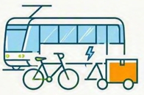
Decarbonising urban mobility and logistics
Unlocking the enabling conditions for a coordinated city-wide system that delivers reliable zero-emission movement and reallocates street space towards cleaner, safer and more productive uses.
Why now
  Decisions taken today on housing, commercial districts, transport infrastructure, depots and parking shape travel demand for decades. E-commerce and platform delivery keep raising pressure on freight systems, while expectations for cleaner air and safer streets keep rising.
What is blocking progress
  Responsibilities are spread across transport, planning, public works, parking and enforcement, with no single actor accountable. Pilots lack a pathway to city-wide implementation. Data on deliveries, kerb use and parking is unreliable. Consolidation hubs struggle for viability, parking reform is politically sensitive and enforcement capacity is thin.
Potential pathways
  Integrated mobility and logistics governance · Zero-emission access and managed kerb systems · Consolidated and zero-emission urban logistics networks · Car-dependence reduction and street-space transformation
Notes:
Worth stressing: most cities already have mobility plans, and these approaches have been tested widely. What is missing is not more testing or more planning – it is implementation, and the governance, financing and coordination models that let plans actually get delivered and scaled.

Slide 23
Choosing your challenge area
Choose the area that resonates most (where your diagnosed barriers genuinely sit) and anchor the rationale for your intervention within it.
The primary challenge area question on the platform must contain a selected challenge (a secondary area is optional).
Assessment focuses on the depth of your diagnosis and the credibility of your pathway, not on redefining or extending the thematic scope.
The areas are not silos. You can work transversally – bringing nature-based solutions into a mobility programme, or using finance as the route into an emission-domain challenge – as long as the anchor is clear.
In short, the challenge area briefs and guideline define the what. You define the how, starting from your own context, actors and bottlenecks.

Slide 24
Scope

Slide 25





Eligible activities
Four categories of eligible activities
Proposals may combine categories, framed by their intended change.
Pioneering activities – new technologies, processes, services, policy instruments, governance models and integrated cross-sectoral solutions
Two cross-cutting requirements
Systemic, science-based innovative initiatives – translating research and R&I outcomes into policies, standards, planning tools and investment decisions
Do No Significant Harm must be respected across all activities
Capacity and capability building – training, new operational roles, and financial, legal, procurement and project-delivery capability
Inclusion, accessibility and just transition are embedded into durable structures and processes, not as add-ons
Collaborative governance and community building – multi-stakeholder platforms, embedded citizen engagement, cross-departmental governance innovation

Slide 26





What your proposal should deliver
1
Proposals are expected to deliver
2
Two required deliverables
innovative or enabling solutions piloted, adapted or implemented at city level
Standardised indicator values and baselines for each selected indicator
operationalised enabling measures that support large-scale implementation – new delivery models, governance arrangements, regulatory approaches, investment mechanisms or procurement frameworks
strengthened institutional capacity within the administration and key local actors
At least one knowledge asset in English, for replication in another city
collaborative and inclusive governance arrangements with genuine shared ownership

Slide 27
What ECT2 will not prioritise
Early-stage experimentation without a credible institutionalisation route
Standalone pilots that do not change operating models, policy, budget or procurement
Technology trials without delivery integration, financing and policy embedment
Straightforward replication of approaches already proven or tested, where little new learning, adaptation or transformative value is expected
The test is not novelty for its own sake. It is whether the work changes how the city operates once the grant ends.

Slide 28
A portfolio, not a set of projects
ECT2 expands a strategic portfolio designed to produce results and adoption beyond individual cities.
Priority goes to proposals with innovative potential, and to transferable “how-to” assets backed by clear evidence. Replication and institutional adoption are core outcomes, not optional learning benefits.
Applicants are encouraged to signal openness to collaboration across the portfolio.
Funding decisions are made at portfolio level, not solely at the level of an individual proposal. A high-scoring proposal may not be funded if it does not strengthen portfolio coherence; a slightly lower-scoring one may be funded if it fills a critical gap.
Once selected, Boot Camp and Collective Sensemaking are where synergies between interventions get identified and built.

Slide 29
Impact

Slide 30
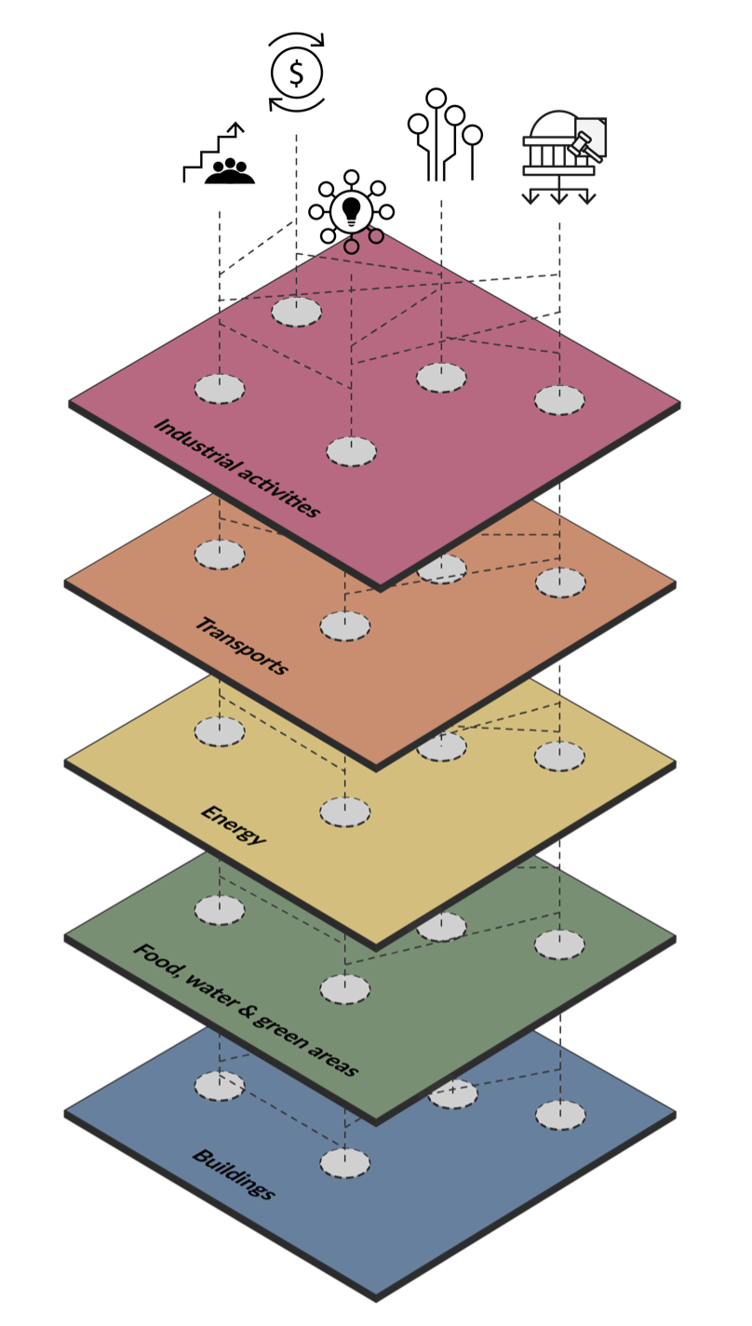
Multiple levers for change
Combining multiple levers and cross-cutting approaches is expected to be essential for systemic impact. Proposals should include one or several:
  Governance and policy – obstacles and opportunities in the policy and regulatory system, and what multi-level governance makes possible
  Participation, partnerships and engagement – most emissions sit beyond direct municipal control
  Procurement – aggregated purchasing power shaping markets and creating predictable demand
  Finance and funding – structuring approaches that overcome recurring finance obstacles
  Data & digitalisation – improving public services and platform for evidence informed decision-making and foresight
  Capacities and capabilities – learning by doing to build better conditions for delivery and impact within your organisations and ecosystems

Slide 31
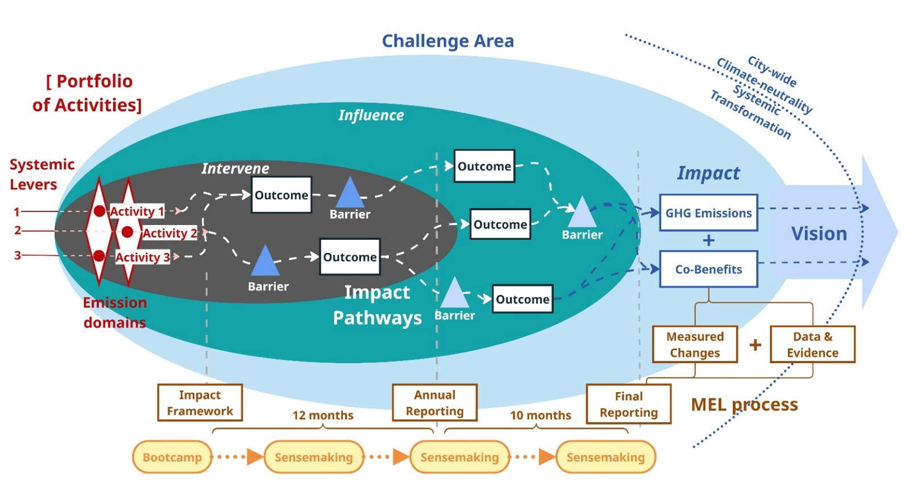
Impact pathways
Connected short- and medium-term outcomes unlocked through implementation;
Show how a city progresses from actions to long-term impacts and
how real-world change is expected to happen

Slide 32
Impact pathways to measure progress
Your pathway should show:
  what success looks like in addressing systemic barriers within your challenge area
  clear assumptions, learning opportunities, and signals of change
  select the most appropriate indicators to measure, evidence and signal impact
  how results contribute to wider deployment, replicable knowledge, scaling and institutional adoption
ECT2 Impact Framework provides the structure for how that change will be monitored, evidenced and reported
MEL Info Session in detail on 9th October.

Slide 33
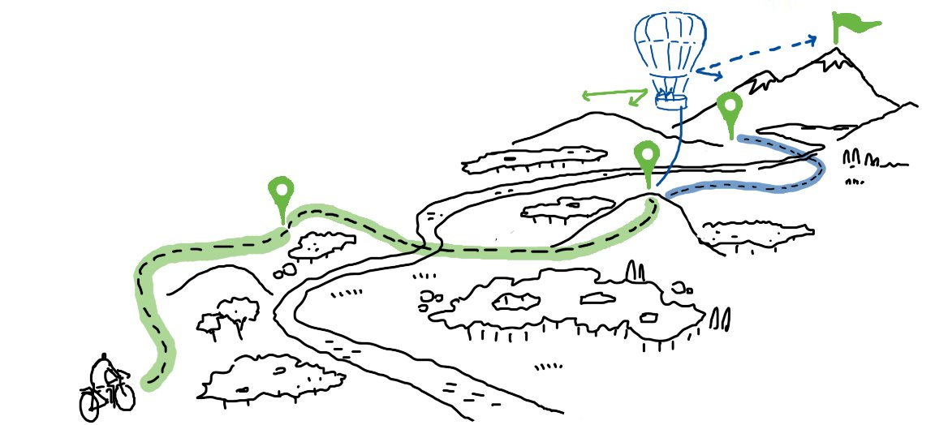
MEL and Collective Sensemaking
Monitoring, Evaluation, Learning (MEL) is a core delivery and improvement mechanism, not only an accountability requirement. It helps cities evidence observable change, remove blockers and enable scaling & replication.
Proposals include an Impact Framework: intended Outcomes, Signals of Change, indicator selection and metrics for measurement
Quantitative Indicators of two types: mandatory standardised GHG and co-benefit indicators selected from the ECT2 Indicator Set (45 indicators: 12 GHG, 33 co-benefits), plus optional customised indicators of your own.
Up to four Collective Sensemaking rounds are planned, one in-person event. Budget will be available for the travel.
Indicators and outcomes are a starting point, not frozen – they can be refined during grant agreement prep.
Full detail in MEL Info Session on 9th October.

Slide 34
Timeline and Key information

Slide 35
The call at a glance
CALL IDENTITY
NZC-SGA3-HE-202608 · Horizon Europe Grant Agreement 101261829 (SGA3-NZC)
OPENS
31 August 2026, 12.00 CET
DEADLINE
3 December 2026, 12.00 CET
No late or out-of-system submissions; no modification after submission
BUDGET
€8 million total
Subgrants: €500,000 – €1,500,000
DURATION
22 months
April 2027 – January 2029
LANGUAGE
English
Supporting docs may use local language + English summary
AI USE
100% human accountability
Disclose AI tools used; evident/predominant AI use will be penalised

Slide 36
Who can apply
ELIGIBLE APPLICANT
A local authority or city administration designated as an EU Mission City (100 Climate-Neutral and Smart Cities by 2030)
PROPOSAL LEAD
Mission City administration — min. 2 legal entities in the consortium
CONSORTIUM PARTNERS
Research institutions, universities, SMEs, NGOs, associations, citizen groups and other relevant stakeholders
NZC Consortium Partners cannot participate
HIGHER-LEVEL GOVERNANCE (OPTIONAL)
A metropolis, region or national department — only with a formal governance link to the Mission City
Doesn’t count towards the Mission City count, unless it is itself the Mission City
APPLIES TO EVERY PROPOSAL
ONE PER CITY
One proposal per city or district — no territorial double-funding. Coordinate across administrative levels before applying.
CONSORTIUM AGREEMENT
Should be signed before the Award Agreement. The DESCA model is recommended.

Slide 37





Funding envelopes and budget rules
Funding envelopes
Budget rules
•
€ 500.000: minimum one Mission City plus at least one additional consortium partner
•
Two/thirds: At least two legal entities must hold budget; no single entity may hold more than two-thirds of the total subgrant requested
.
•
€ 1.00.000: minimum two distinct Mission Cities, plus any additional partners
•
Actual costs: Reimbursement against actual costs incurred (HE cost categories); indirect costs at 25% of personnel, travel, equipment and other goods and services (value for money)
•
€ 1.500.000: minimum three Mission City plus at least one additional consortium partner.
•
Build-in: coordination effort for the lead city, a systemic innovation focal point (3–4 person months), travel for the in-person Boot Camp and Sensemaking events, communication and dissemination, and a CFS for consortium leads

Slide 38
Call timeline
31 August 2026
Call opens, guidelines published
3 December 2026
Call deadline, 12.00 CET
5 February 2027
Decision communication, with feedback
19 February 2027
Publication of outcomes and selected cities
31 January 2029
Programme concludes
15, 29 Sep & 9 Oct 2026
Information sessions, all 11.00 CET
Dec 2026 – Jan 2027
Eligibility check, expert assessment, portfolio selection
5–12 February 2027
Appeals and complaints window
1 April 2027
Programme launch, once due diligence complete and grant agreement signed

Slide 39
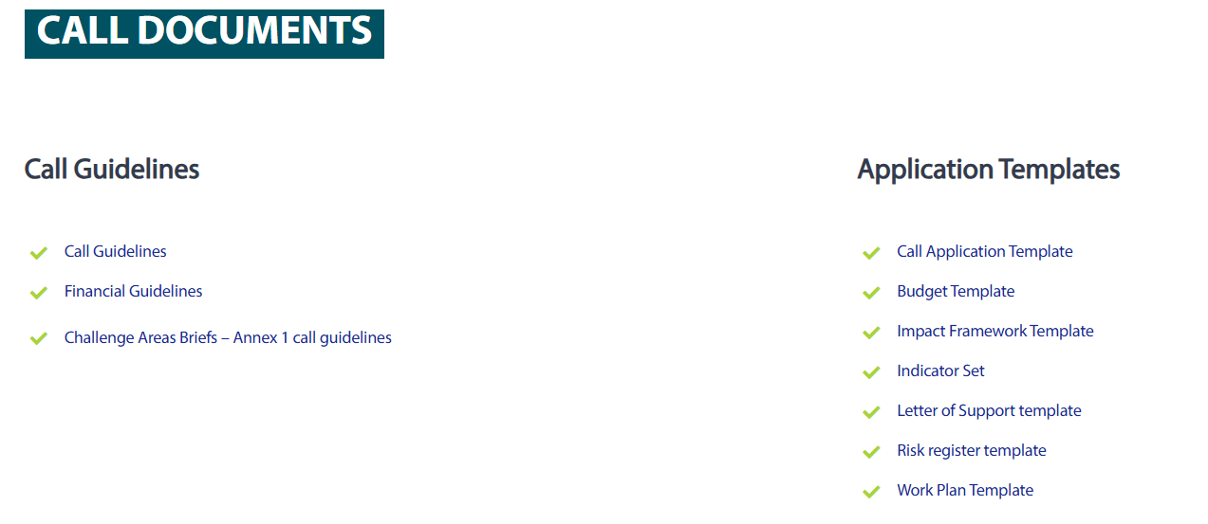
Call documentation
All available on the NetZeroCities website. Please note: content drafted in the call application, risks and work plan templates must be transferred manually into the submission platform.

Slide 40
Next steps
3 DECEMBER 2026
Call deadline, 12.00 CET
ONGOING
Check the NetZeroCities website
≥ 1 WEEK BEFORE DEADLINE
Send queries to ect@netzerocities.eu
THROUGHOUT
Register on the Grant Management System
29 SEP & 9 OCT
Eligibility session
Impact Framework session
NOW
Talk to your City Advisor and peer cities

Slide 41

Q&A

